Slide 1
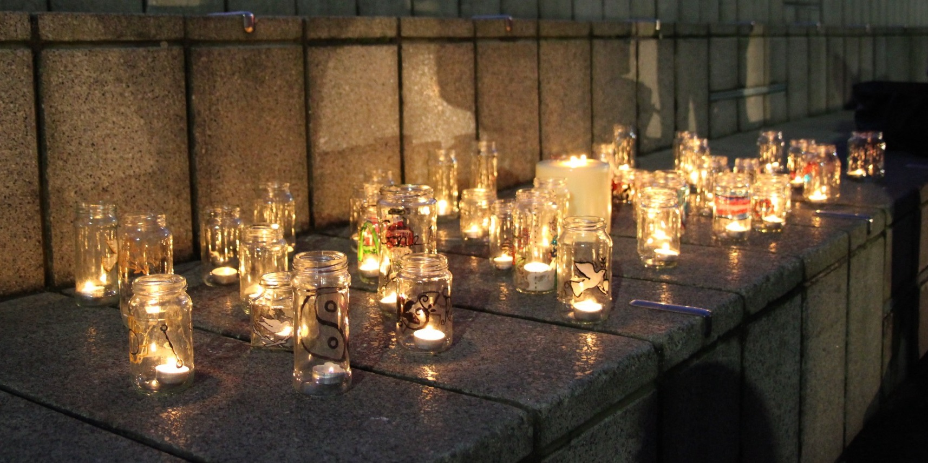
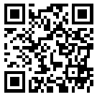
Trans Lives Matter: Remembering Our Dead
Trans Day of Remembrance 2025
https://tdor.translivesmatter.info/

Slide 2
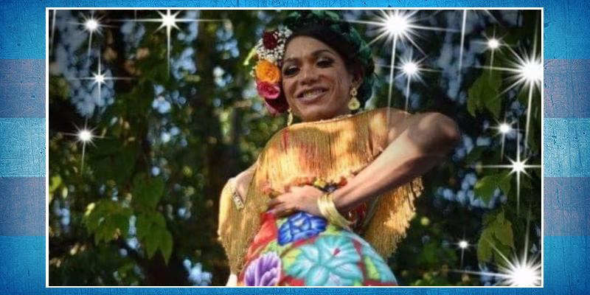
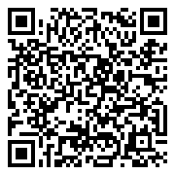

Mayte López Regalado
Tehuantepec, Oaxaca (Mexico)
tortured. 1 Oct 2024

Slide 3
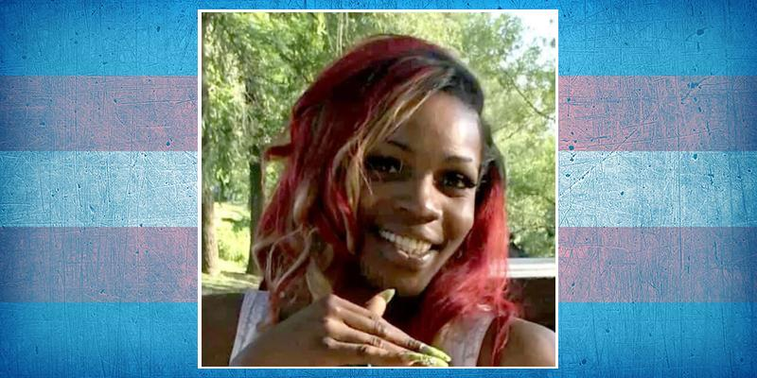
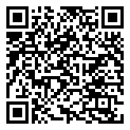
Honee Walker
Age 37
Rochester, New York (USA)
run over. 2 Oct 2024

Slide 4
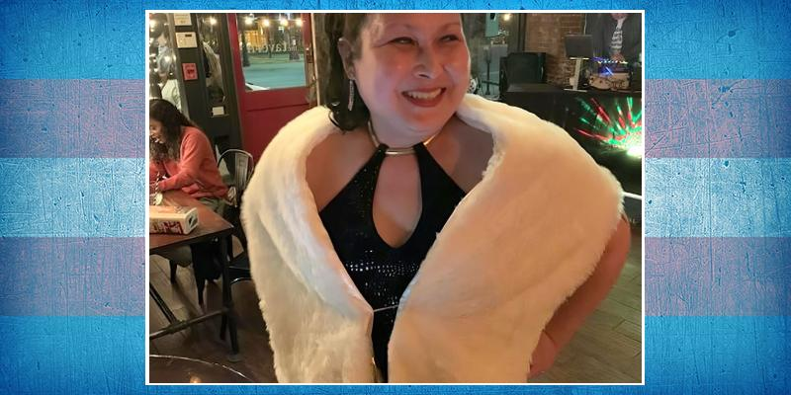
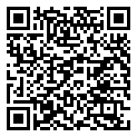
Jill Heathers Bouvier
Age 54
Omaha, Nebraska (USA)
suicide. 3 Oct 2024

Slide 5

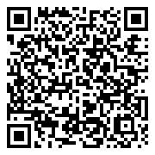
Name Withheld
Age 37
Darwin, Northern Territory (Australia)
stabbed. 7 Oct 2024

Slide 6
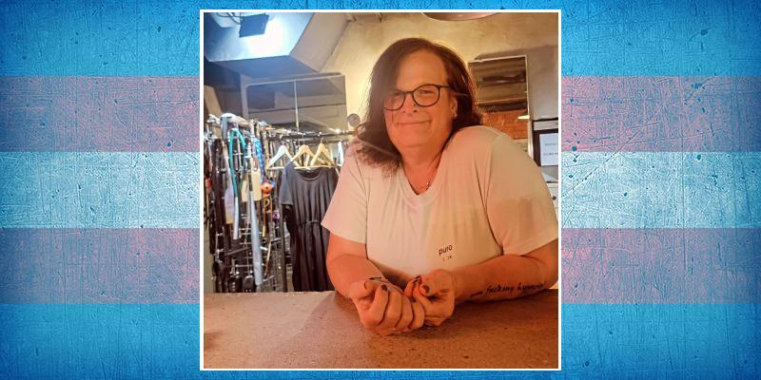
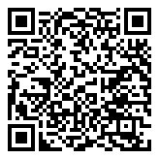
Rynn Azerial Willgohs
Age 52
Vantaa, Uusimaa (Finland)
suicide. 8 Oct 2024

Slide 7
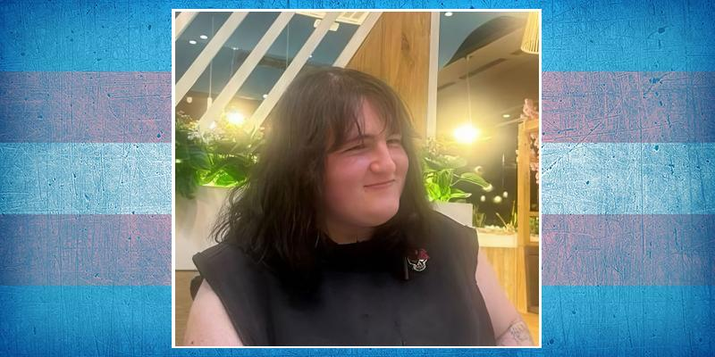
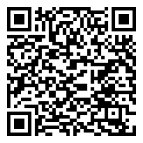
Kaile Villar Pons
Age 20
Pamplona, Navarre (Spain)
stabbed. 9 Oct 2024

Slide 8
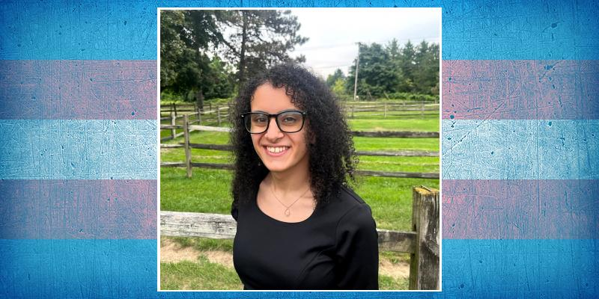
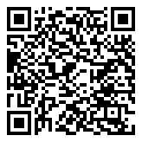
Megan Jordan Kridli
Age 22
Miami, Florida (USA)
suicide. 9 Oct 2024

Slide 9
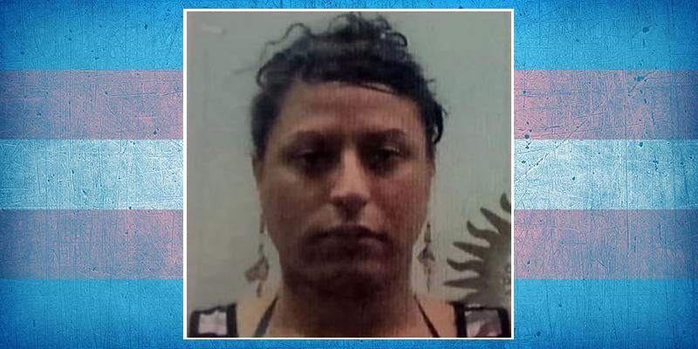
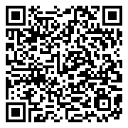
Florencia Luna Reinaldi ("Floppy")
Age 38
Ensenada, Buenos Aires (Argentina)
beaten. 10 Oct 2024

Slide 10
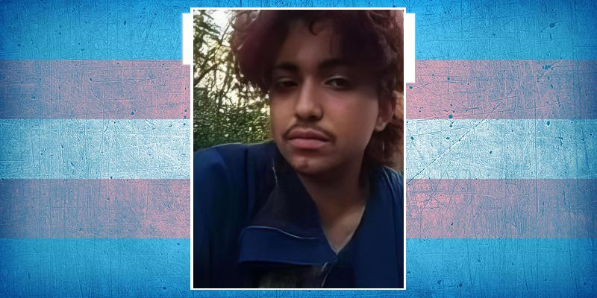
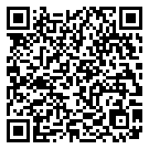
Lionel Gerardo Monteverde Mercano
Age 22
Chillán, Diguillan (Chile)
10 Oct 2024

Slide 11
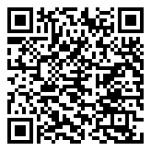
Name Unknown
Age 35-40
Bhokarden, Maharashtra (India)
throat cut. 10 Oct 2024

Slide 12
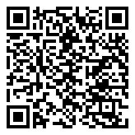
Name Unknown
Age 45-50
Tamaulipas (Mexico)
beaten. 10 Oct 2024

Slide 13
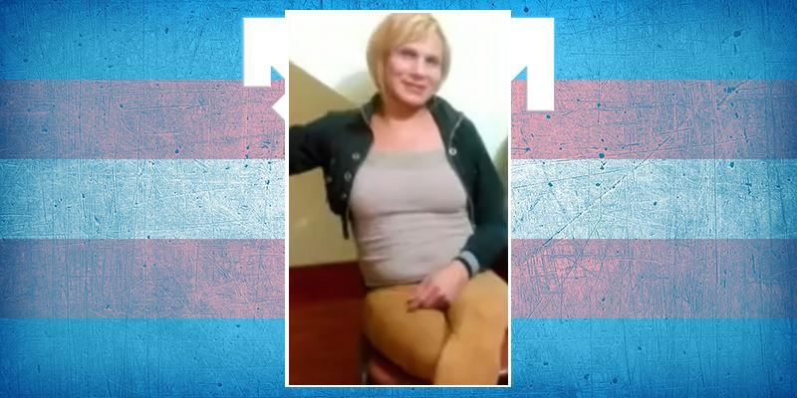
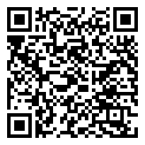
Cris Chirinos Alvarez
Age 54
Ate, Lima (Peru)
stabbed. 11 Oct 2024

Slide 14
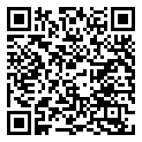
Ayub Ali
Age 47
Tangail (Bangladesh)
strangled. 12 Oct 2024

Slide 15
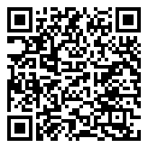
Phoenix Cassetta
Colchester, Vermont (USA)
suicide. 14 Oct 2024

Slide 16
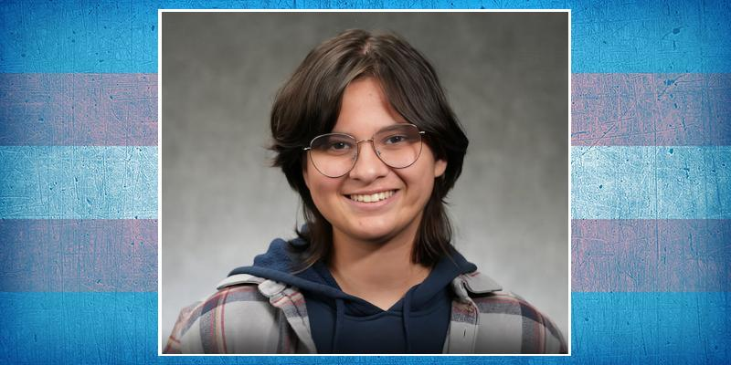
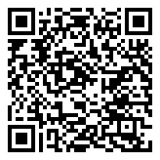
Raven Syed
Lawrenceville, New Jersey (USA)
suicide. 14 Oct 2024

Slide 17
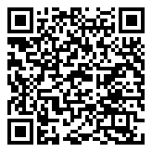
Rick Alastor Newman
Age 29
Bozeman, Montana (USA)
shot. 17 Oct 2024

Slide 18
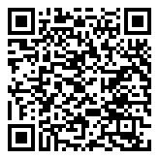
Saritha
Age 33
Hyderabad, Telangana (India)
suicide. 18 Oct 2024

Slide 19
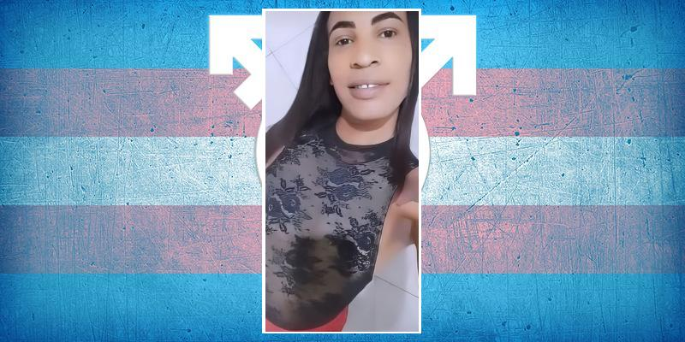
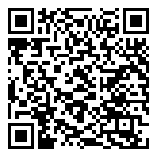
Priscila
Coaraci, Bahia (Brazil)
shot. 19 Oct 2024

Slide 20
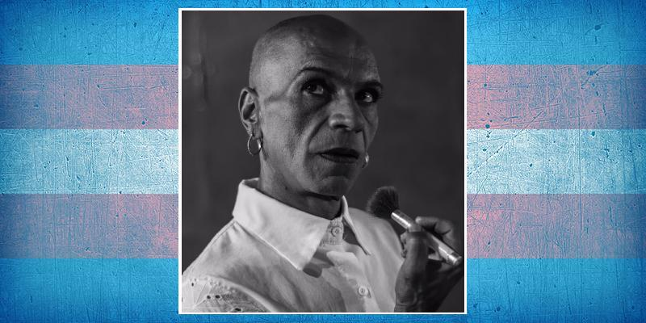
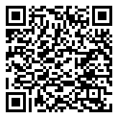
Karis Saldarriaga
Age 61
Caldas, Antioquia (Colombia)
stabbed. 20 Oct 2024

Slide 21
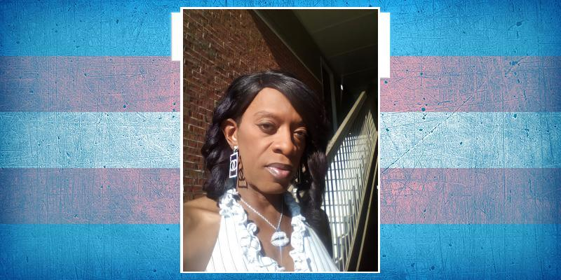
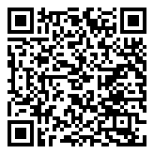
San Coleman
Age 48
Athens, Georgia (USA)
murdered. 20 Oct 2024

Slide 22
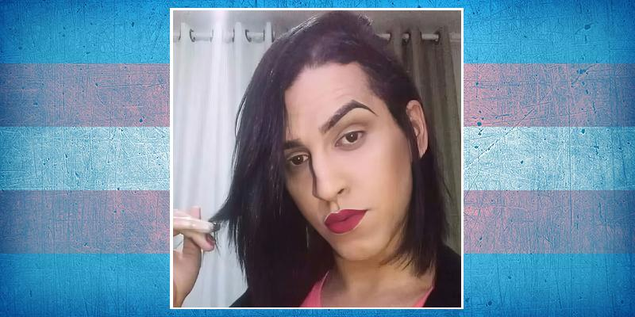
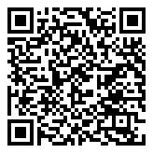
Naira Victória Neris
Age 27
São Paulo (Brazil)
tortured and stabbed. 20 Oct 2024

Slide 23
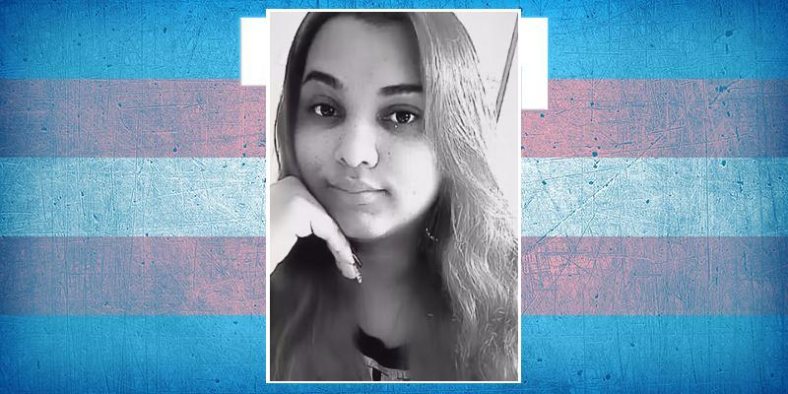
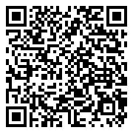
Amanda Eduarda Rios
Age 28
São Carlos, São Paulo (Brazil)
asphixiated. 21 Oct 2024

Slide 24
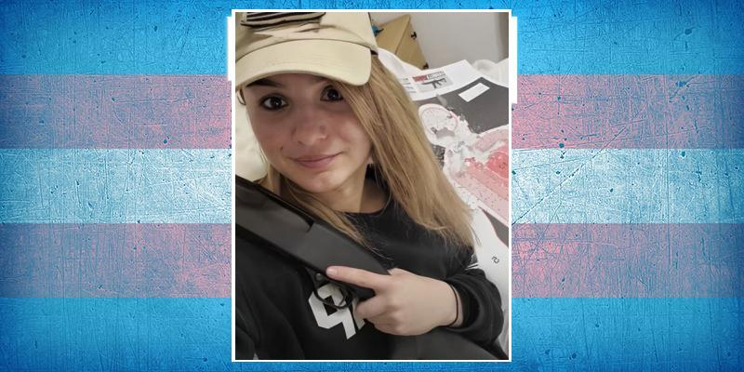
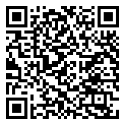
Allyson Ketchum ("Alex")
Age 29
Mesa, Arizona (USA)
suicide. 22 Oct 2024

Slide 25
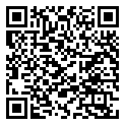
Nazak
Mardan, Khyber Pakhtunkhwa (Pakistan)
stabbed. 22 Oct 2024

Slide 26
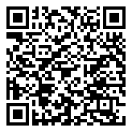
Salmanay
Mardan, Khyber Pakhtunkhwa (Pakistan)
stabbed. 22 Oct 2024

Slide 27
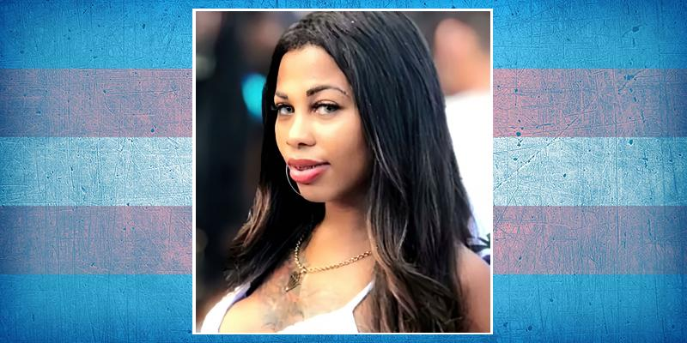
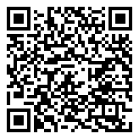
Luane Costa da Silva
Age 27
Santos, São Paulo (Brazil)
strangled. 23 Oct 2024

Slide 28
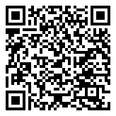
Soraya Ruíz
Age 42
Buenos Aires (Argentina)
shot. 23 Oct 2024

Slide 29
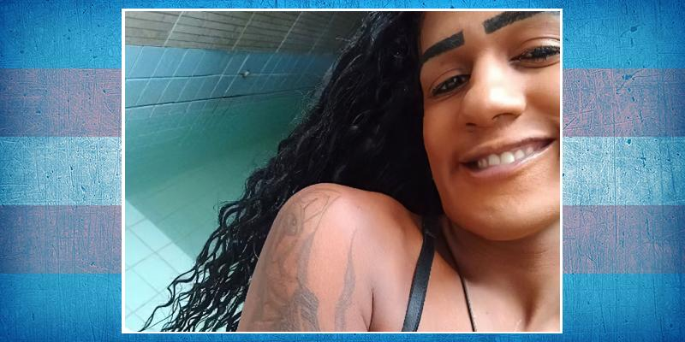
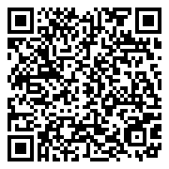
Evellyn Marcelly ("Evinha")
Age About 30
Recife, Pernambuco (Brazil)
suffocated. 24 Oct 2024

Slide 30
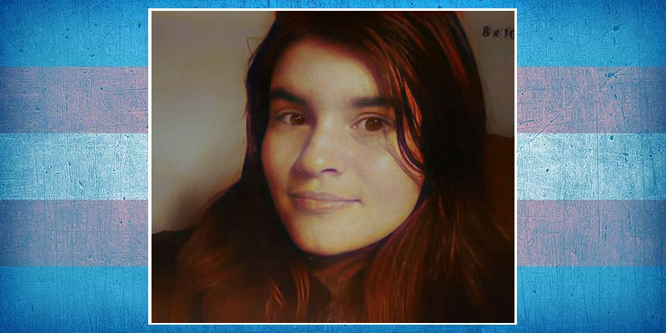
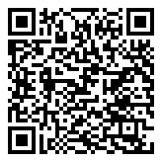
Jay Floris
Age 23
Stockton, California (USA)
run over. 24 Oct 2024

Slide 31


Frida
Age 50
Paris (France)
24 Oct 2024

Slide 32


Débora Myrante Silva
Age 42
Cruzeiro, São Paulo (Brazil)
stabbed. 25 Oct 2024

Slide 33


Dylan Amaya Cardona
Age 33
Pereira, Risalda (Colombia)
stabbed. 25 Oct 2024

Slide 34


Leah Jo
Age 37
Denver, Colorado (USA)
suicide. 25 Oct 2024

Slide 35

Laisa Camacho
Age 56
El Carmen de Cartago (Costa Rica)
stabbed. 27 Oct 2024

Slide 36


Serenity Birdsong
Age 21
Murfreesboro, Tennessee (USA)
suicide. 28 Oct 2024

Slide 37


Juana Castañeda
Age 33
Medellín, Antioquia (Colombia)
stabbed. 28 Oct 2024

Slide 38

Yumiko
Cochabamba (Bolivia)
beaten. 28 Oct 2024

Slide 39


Cal Shearer
Age 25
Oxford, Oxfordshire (United Kingdom)
suicide. 30 Oct 2024

Slide 40


Spencer James Kastl
Age 22
Saint Louis Park, Minnesota (USA)
31 Oct 2024

Slide 41


Isabela dos Santos
Age 26
Peixoto de Azevedo, Mato Grosso (Brazil)
shot. 31 Oct 2024

Slide 42


Grecia Sandoval
Colima (Mexico)
shot. 1 Nov 2024

Slide 43


Rosario Sansone
Age 47
Bahia Blanca, Buenos Aires (Argentina)
murdered. 3 Nov 2024

Slide 44

Fidy Shaikh
Jacobabad, Sindh (Pakistan)
stabbed. 5 Nov 2024

Slide 45


Sydney Leigh Phillips ("Syd")
Age 22
East Islip, New York (USA)
suicide. 5 Nov 2024

Slide 46


Rita Pilar Almirón
Age 32
Colón, Entre Ríos (Argentina)
burnt alive. 7 Nov 2024

Slide 47

Name Unknown
USA
suicide. 7 Nov 2024

Slide 48

Alejandra M
Ciudad Portoviejo, Manabi (Ecuador)
7 Nov 2024

Slide 49

Wendolyn Peligrino Abellana
Age 32
Cebu City (Philippines)
shot. 7 Nov 2024

Slide 50


Quanesha Shantel ("Cocoa")
Age 25
Greensboro, North Carolina (USA)
shot. 10 Nov 2024

Slide 51


Santrosa
Age 27
Sinop, Mato Grosso (Brazil)
tortured and decapitated. 10 Nov 2024

Slide 52


Kyla Jane Walker
Age 39
Austin, Texas (USA)
run over. 10 Nov 2024

Slide 53


Disneys Borrero
San Miguel del Padrón, La Habana (Cuba)
murdered. 10 Nov 2024

Slide 54

Leia Sampson-Grimbly
Age 17
Suffolk (United Kingdom)
suicide. 11 Nov 2024

Slide 55


Camila Vásquez Guzmán
Age 28
Manizales, Caldas (Colombia)
stabbed. 16 Nov 2024

Slide 56

Sonakshi
Quetta, Balochistan (Pakistan)
tortured. 16 Nov 2024

Slide 57

Kajal ("Coca Cola")
Baloda Bazar, Chhattisgarh (India)
stabbed. 17 Nov 2024

Slide 58

Name Unknown
Age 49
Santos, São Paulo (Brazil)
murdered. 25 Nov 2024

Slide 59


Hasini
Nellore, Andhra Pradesh (India)
stabbed. 26 Nov 2024

Slide 60

Sanjana Kunwar
Age 39
Umarwada, Surat (India)
stabbed. 27 Nov 2024

Slide 61

Jhessyka Loren Loran Bezerra de Lima
Age 43
Maceió, Alagoas (Brazil)
shot. 30 Nov 2024

Slide 62


Ashli Woodgate
Age 20
Norwich, East Anglia (United Kingdom)
overdose. 1 Dec 2024

Slide 63


Mau Hijra
Jessore (Bangladesh)
1 Dec 2024

Slide 64


Ra'lasia Wright
Age 25
Minneapolis, Minnesota (USA)
shot. 1 Dec 2024

Slide 65


Geminis Aparicio
Age 18
Tijuana, Baja California (Mexico)
run-over. 1 Dec 2024

Slide 66


E. Nascimento de Lima
Age 34
Jataí, Goiás (Brazil)
stabbed. 2 Dec 2024

Slide 67


Pétala Espírito Santo Monteiro
Age 20
Castanhal, Pará (Brazil)
shot. 2 Dec 2024

Slide 68

Name Unknown
Ciudad Juárez, Chihuahua (Mexico)
3 Dec 2024

Slide 69


Alana de Jesus ("Alana do Uber")
Age 27
Matozinhos, Minas Gerais (Brazil)
shot. 4 Dec 2024

Slide 70

Name Unknown
Ribeirão Preto, São Paulo (Brazil)
beaten. 4 Dec 2024

Slide 71

Name Unknown
Rio Verde, Goiás (Brazil)
shot. 4 Dec 2024

Slide 72

Rayra Rios
Russas, Ceará (Brazil)
shot. 5 Dec 2024

Slide 73


Thitikarn Dulikanon ("Dr Sammy")
Chiang Mai (Thailand)
strangled. 6 Dec 2024

Slide 74

Erika
Guayaquil, Guayas (Ecuador)
shot. 6 Dec 2024

Slide 75


Preta Gil
Boca da Mata, Alagoas (Brazil)
shot. 7 Dec 2024

Slide 76

Name Unknown
Age 38
Canoas, Rio Grande do Sul (Brazil)
shot. 7 Dec 2024

Slide 77


Roy Mora
Age 15
Fort Bragg, California (USA)
suicide. 7 Dec 2024

Slide 78


Berinjela
Jequié, Bahia (Brazil)
shot. 10 Dec 2024

Slide 79

Rafaela Lorena Soares da Rocha
Brasilia, Distrito Federal (Brazil)
asphixiated. 10 Dec 2024

Slide 80

Monalisa
Fortaleza, Ceará (Brazil)
shot. 11 Dec 2024

Slide 81


Tamara Zuñiga Azcona
Pochutla, Oaxaca (Mexico)
stabbed. 13 Dec 2024

Slide 82


Neuritânia Pacheco
Age 48
Sobradinho, Bahia (Brazil)
stoned. 14 Dec 2024

Slide 83


Aziza Barnes ("Z")
Age 31
Oxford, Mississippi (USA)
suicide. 15 Dec 2024

Slide 84


Mayla Gomes
Novo Progresso, Pará (Brazil)
murdered. 16 Dec 2024

Slide 85


Cam Thompson
Age 18
Tuscaloosa, Alabama (USA)
shot. 16 Dec 2024

Slide 86

J. Hermes
Age 36
Chihuahua (Mexico)
shot. 17 Dec 2024

Slide 87


Bianca Castyel ("Bia")
Age 20
Água Boa, Mato Grosso (Brazil)
stabbed. 19 Dec 2024

Slide 88

Pari Bibi
Age 22
Faisalabad, Punjab (Pakistan)
poisoned. 20 Dec 2024

Slide 89


Thayla Aylla
Age 24
Várzea Grande, Mato Grosso (Brazil)
stabbed. 23 Dec 2024

Slide 90


Meka Shabazz
Age 46
Columbus, Ohio (USA)
suicide. 23 Dec 2024

Slide 91


Roberta Guimarães da Silva ("Rogéria")
Fortaleza, Ceará (Brazil)
fell. 23 Dec 2024

Slide 92

Anjali
Age 32
Dijkot, Punjab (Pakistan)
strangled. 25 Dec 2024

Slide 93


Mirella Albuquerque
Age 21
Cabo de Santo Agostinho, Pernambuco (Brazil)
stabbed. 25 Dec 2024

Slide 94


River Trevino
Age 32
Portland, Oregon (USA)
suicide. 27 Dec 2024

Slide 95


Ganga Kinnar
Varanasi, Uttar Praddesh (India)
shot. 29 Dec 2024

Slide 96

Jota Nogueira Oliveira
Age 30
Manaus, Amazonas (Brazil)
strangled. 29 Dec 2024

Slide 97

Rafaela de Sousa Oliveira
Teresina, Piauí (Brazil)
shot. 29 Dec 2024

Slide 98


Micaela Arévalo
Age 22
Quilmes Oeste, Buenos Aires (Argentina)
throat cut. 29 Dec 2024

Slide 99


Andreína García García
Age 50
Medellín, Antioquia (Colombia)
stabbed. 31 Dec 2024

Slide 100


Jonny Adamow
Age 29
Seattle, Washington (USA)
shot. 31 Dec 2024

Slide 101


Nikhole Souza
São Paulo (Brazil)
shot. 31 Dec 2024

Slide 102


Jeane Lui ("Jeje Sucesso")
Age 32
Belo Horizonte, Minas Gerais (Brazil)
shot. 2 Jan 2025

Slide 103


Eliarlan dos Santos
Age 48
Santana do Acaraú, Ceará (Brazil)
shot. 4 Jan 2025

Slide 104


Gabriela Araújo Santos
Age 26
Novo Gama, Goiás (Brazil)
stabbed. 6 Jan 2025

Slide 105

Giorgio
Age 14
Caserta (Italy)
suicide. 6 Jan 2025

Slide 106

Name Unknown
Age about 25
Bhagalpur, Bihar (India)
possible suicide. 8 Jan 2025

Slide 107


Parker Savarese
Age 15
Setauket, New York (USA)
possible suicide. 8 Jan 2025

Slide 108


Natalia Santodomingo
Cajicá, Cundinamarca (Colombia)
murdered. 9 Jan 2025

Slide 109


Zulma Hernández Mendoza
Age 43
Santiago Jamiltepec, Oaxaca (Mexico)
shot. 10 Jan 2025

Slide 110


Gabriela Rojas ("La Rorra")
Chietla, Puebla (Mexico)
possible suicide. 10 Jan 2025

Slide 111

Adige Shashank
Age 14
Nirmal, Telanga (India)
beaten and strangled. 10 Jan 2025

Slide 112


Betsy Mariel
Age 32
Cúcuta, Santander (Colombia)
shot. 11 Jan 2025

Slide 113


Alejandra Jiménez Susan ("Khloe")
Age 20
Tacotalpa, Tabasco (Mexico)
stabbed. 13 Jan 2025

Slide 114


Diany Ruiz
Barrancabermeja, Santander (Colombia)
shot. 13 Jan 2025

Slide 115

C. Hernández Cutiño
Age 31
Juchitán, Oaxaca (Mexico)
shot. 13 Jan 2025

Slide 116


Sarang Punekar
Age 30
Rajasthan, Pune (India)
suicide. 15 Jan 2025

Slide 117


Ren Tampus
Age 35
General Santos, South Cotabato (Philippines)
shot. 15 Jan 2025

Slide 118


Stephanie Francesca ("Steph")
Age 36
Basildon, Essex (United Kingdom)
suicide. 15 Jan 2025

Slide 119

Name Unknown
Tijuana, Baja California (Mexico)
burned. 17 Jan 2025

Slide 120


Pamela Mirella
Age 31
Campo Grande, Mato Grosso do Sul (Brazil)
burnt. 21 Jan 2025

Slide 121


Blake Wava Quinlan
Age 19
Huntsville, Ontario (Canada)
possible suicide. 22 Jan 2025

Slide 122

Name Unknown
Age 16
Primavera, Pernambuco (Brazil)
shot. 23 Jan 2025

Slide 123


Carolina
Hispania, Antioquia (Colombia)
shot. 23 Jan 2025

Slide 124


Paula Nascimento Batista
Age 26-27
Atalaia, Alagoas (Brazil)
run over. 25 Jan 2025

Slide 125

Andrea
Age 34
Daule, Guayas (Ecuador)
shot. 26 Jan 2025

Slide 126

Chila Cagua
El Guabo, El Oro (Ecuador)
27 Jan 2025

Slide 127


Elisa Rae Shupe
Syracuse, New York (USA)
suicide. 27 Jan 2025

Slide 128


Kendra Oliva
Age 28
San Manuel, Cortés (Honduras)
28 Jan 2025

Slide 129


Jully Roberta Santos de Vilhena
Age 22
Marituba, Pará (Brazil)
shot. 29 Jan 2025

Slide 130


Ayla Pereira dos Santos
Age 18
Tangará da Serra, Mato Grosso (Brazil)
tortured. 29 Jan 2025

Slide 131


Thayla da Costa Vieira
Age 25
Sapezal, Mato Grosso (Brazil)
stabbed and decapitated. 31 Jan 2025

Slide 132


Aubrey Dameron
Age 25
Ottawa County, Oklahoma (USA)
murdered. 31 Jan 2025

Slide 133

Name Unknown
Age 35
Huehuetoca, Estado de México (Mexico)
31 Jan 2025

Slide 134

Chidia/Chiriya
Bahawalnagar, South Punjab (Pakistan)
shot. 2 Feb 2025

Slide 135


Cansu
Alsancak, İzmir (Turkey)
suicide. 2 Feb 2025

Slide 136


Shila
Betbunia, Rangamati (Bangladesh)
stabbed and throat cut. 3 Feb 2025

Slide 137


Daniela Muttis
Riohacha, La Guajira (Colombia)
shot. 4 Feb 2025

Slide 138


Larissa Patrícia Polianna ("Buiu a Bonita")
Manaus, Amazonas (Brazil)
run over. 8 Feb 2025

Slide 139


Tahiry Broom
Age 29
Southfield, Michigan (USA)
shot. 11 Feb 2025

Slide 140


Gulalai
Age 23
Charsadda, Khyber Pakhtunkhwa (Pakistan)
shot and strangled. 13 Feb 2025

Slide 141


Sam Nordquist
Age 24
Canandaigua, New York (USA)
tortured and beaten. 14 Feb 2025

Slide 142

Sofia
Age about 30
Betim, Minas Gerais (Brazil)
shot. 14 Feb 2025

Slide 143

Name Unknown
Age 30-40
Hyderabad, Telegana (India)
15 Feb 2025

Slide 144


Ervianna Johnson
Age 25
Tabor City, North Carolina (USA)
16 Feb 2025

Slide 145


Ryan Enrique Skates
Age 16
Berkley, Michigan (USA)
suicide. 18 Feb 2025

Slide 146


Pâmela Nunes Valadares
Age 28
Frutal, Minas Gerais (Brazil)
beaten, strangled and hanged. 19 Feb 2025

Slide 147


J. Rodrigues da Silva
João Câmara, Rio Grande do Norte (Brazil)
murdered. 20 Feb 2025

Slide 148


Amyri Dior
Age 23
Milwaukee, Wisconsin (USA)
shot. 21 Feb 2025

Slide 149


Shalani Dolina
Age 37
Caloocan, Metro Manilla (Philippines)
dismembered. 21 Feb 2025

Slide 150


Jennifer Michaell Chávez Ramos
Age 23
Zapopan, Jalisco (Mexico)
kidnapped and murdered. 26 Feb 2025

Slide 151


Arina Nefs Demchuk
Age 26
Murino, Leningrad Oblast (Russia)
murdered and dismembered. 26 Feb 2025

Slide 152


Linda Becerra Moran
Age 30
Los Angeles, California (USA)
shot. 27 Feb 2025

Slide 153


Paola Brattcho
Ananindeua, Pará (Brazil)
stabbed. 28 Feb 2025

Slide 154

Name Unknown
Aracaju, Sergipe (Brazil)
28 Feb 2025

Slide 155


Sheik Oliveros Quintana
Age 30
Caucasia, Antioquia (Colombia)
shot. 1 Mar 2025

Slide 156


Tailyn Valencia
Age 30-40
Medellín, Antioquia (Colombia)
beaten. 4 Mar 2025

Slide 157


Jordan "JJ" Maye
Age 17
Ocean Springs, Mississippi (USA)
suicide. 8 Mar 2025

Slide 158

Saba
Narowal, Punjab (Pakistan)
shot. 9 Mar 2025

Slide 159


Kildery Dionny Dourado Pereira
São Luís, Maranhão (Brazil)
beaten. 15 Mar 2025

Slide 160


Ana Paula
Sobral, Ceará (Brazil)
stabbed. 17 Mar 2025

Slide 161


Indira Deepa
Age 36
Anakapalli, Andhra Pradesh (India)
raped, murdered and dismembered. 19 Mar 2025

Slide 162


Davide Garufo
Age 21
Milan, Lombardy (Italy)
suicide. 19 Mar 2025

Slide 163


Charlene Cook
Age 57
Oxford, Mississippi (USA)
shot. 21 Mar 2025

Slide 164


Dandara Vick
Age 24
Campo Grande, Mato Grosso do Sul (Brazil)
suffocated. 23 Mar 2025

Slide 165

Name Unknown
Andes, Antioquia (Colombia)
stabbed and decapitated. 24 Mar 2025

Slide 166


Katelyn Rinnetta Benoit
Age 15
Rochester, New York (USA)
suicide. 24 Mar 2025

Slide 167


Alice Serov/Alisa Serova
Age 17
Westerwolde, Groningen (Netherlands)
suicide. 27 Mar 2025

Slide 168

Degai
Charsadda, Khyber Pakhtunkhwa (Pakistan)
shot. 30 Mar 2025

Slide 169


Alicia
Quechultenango, Guerrero (Mexico)
stabbed. 30 Mar 2025

Slide 170


Kaitoria Le’Cynthia Bankz ("Kai")
Age 31
Autaugaville, Alabama (USA)
shot. 31 Mar 2025

Slide 171

María Paula Peláez
Age 35
Armenia, Quindio (Colombia)
asphyxiated. 31 Mar 2025

Slide 172


Rebeca de Paulo
Age 46
Nova Russas, Ceará (Brazil)
beaten. 31 Mar 2025

Slide 173

Babalú
Currais Novos, Rio Grande do Norte (Brazil)
shot. 1 Apr 2025

Slide 174

Shagufta
Nowshera, Khyber Pakhtunkhwa (Pakistan)
shot. 2 Apr 2025

Slide 175


Mía Zurí Gutiérrez Ramírez
Age 20
Corrientes (Argentina)
suicide. 2 Apr 2025

Slide 176


Marcela Valentina
Age 20
Maceió, Alagoas (Brazil)
raped and beaten. 4 Apr 2025

Slide 177


Faith Roberts
Age 19
Farnham, Surrey (United Kingdom)
suicide. 4 Apr 2025

Slide 178


Sara Millerey
Age 32
Bello, Antioquia (Colombia)
beaten and thrown into a ravine. 5 Apr 2025

Slide 179


Jennifer
Age 23
Abidjan (Ivory Coast)
stabbed. 5 Apr 2025

Slide 180


Norah Horwitz
Age 38
Virginia Beach (USA)
suicide. 7 Apr 2025

Slide 181


Shakira Pereira Guajajara
Age 23
Grajaú, Maranhão (Brazil)
drowned. 7 Apr 2025

Slide 182

Bablu/Talha
Sialkot, Punjab (Pakistan)
stabbed. 10 Apr 2025

Slide 183

Archita
Age 32
Berhampur, Odisha (India)
suicide. 12 Apr 2025

Slide 184

Valeria
Guayaquil, Guayas (Ecuador)
shot. 15 Apr 2025

Slide 185


J. Jady de Souza Oliveira
Age 22
Mossóro, Rio Grande do Norte (Brazil)
stabbed. 16 Apr 2025

Slide 186


Robson Brendo da Silva
Age 29
Extremoz, Rio Grande do Norte (Brazil)
shot. 17 Apr 2025

Slide 187


Alexandra Ruiz
Age 51
Pinamar, Canelones (Uruguay)
shot. 18 Apr 2025

Slide 188


Tanushree
Age 38
Bengaluru, Karnataka (India)
stabbed. 20 Apr 2025

Slide 189


Francisco Cadavid
Age 64
Medellín, Antioquia (Colombia)
beaten. 21 Apr 2025

Slide 190


Ivanna Pérez
Palencia, Guatemala (Guatemala)
murdered. 21 Apr 2025

Slide 191

Eris Palm
Age 23
Hamburg (Germany)
suicide. 22 Apr 2025

Slide 192

Sarut
Bang Kruai, Nonthaburi (Thailand)
suicide. 24 Apr 2025

Slide 193


Kelsey Elem
Age 25
St Louis, Missouri (USA)
shot. 24 Apr 2025

Slide 194


Adeline Claire Johnson
Age 19
Asheville, North Carolina (USA)
suicide. 25 Apr 2025

Slide 195


Lucy Fox
Age 46
Hartlepool, Durham (United Kingdom)
25 Apr 2025

Slide 196


Waranan Pannacha
Age 25
Pattaya, Chonburi (Thailand)
killed and mutilated. 26 Apr 2025

Slide 197


Kira Salim
Age 34
Vancouver, British Colombia (Canada)
run over. 26 Apr 2025

Slide 198


Dahlia Supelanas ("Ka Dahlia")
Age 25
Kabankalan City, Negros Occidental (Philippines)
27 Apr 2025

Slide 199


Lesley Storm
Age 71-72
Edinburgh, Scotland (United Kingdom)
28 Apr 2025

Slide 200

Sophia
United Kingdom
suicide. 30 Apr 2025

Slide 201


Danielly Rocha
Age 38
Rio de Janeiro (Brazil)
murdered. 2 May 2025

Slide 202

Finnela
Age 26
London (United Kingdom)
possible suicide. 4 May 2025

Slide 203


Sophie Sheehan
Age 56
Reading, Berkshire (United Kingdom)
sepsis. 9 May 2025

Slide 204


Tania Monserrat Márquez
Ciudad Juárez, Chihuahua (Mexico)
stabbed and beaten. 10 May 2025

Slide 205


Ángel Jacinto Reina García ("La Fideo")
Age 35
Esmeraldas (Ecuador)
shot. 11 May 2025

Slide 206

Name Unknown
Coatzacoalcos, Veracruz (Mexico)
murdered. 12 May 2025

Slide 207

Name Unknown
Age 47
La Paz (Bolivia)
stabbed. 13 May 2025

Slide 208

Hillary Perpétuo
Age 34
São José do Rio Preto, São Paulo (Brazil)
strangled. 17 May 2025

Slide 209


Shy'Parius Dupree
Age 32
Memphis, Tennessee (USA)
shot. 17 May 2025

Slide 210


Palwasha
Lahore, Punjab (Pakistan)
throat cut. 18 May 2025

Slide 211

Marcial Eustaquio Paucara Cora
Age 48
Tacna (Peru)
asphyxiated. 18 May 2025

Slide 212


Bayron Jhoel Rodríguez Tejada
Age 21
La Unión, Valle del Cauca (Colombia)
shot. 19 May 2025

Slide 213


Catalina Espinoza ("La Osa")
Age 28
Orotina, Alajuela (Costa Rica)
shot. 19 May 2025

Slide 214


Lorena Irisbell Salazar Luisa
Age 24
Salinas, Santa Elena (Ecuador)
shot. 21 May 2025

Slide 215


Nawar Jiménez
Age 30
San Jacinto, Bolivar (Colombia)
murdered. 22 May 2025

Slide 216


Soumya
Age 22
Bhopal, Madhya Pradesh (India)
suicide. 22 May 2025

Slide 217


Wafa
Lahore, Punjab (Pakistan)
shot. 24 May 2025

Slide 218


Karmin Wells
Age 25
Detroit, Michigan (USA)
shot. 24 May 2025

Slide 219


Charlotte Fosgate
Age 17
Portland, Oregon (USA)
suicide. 25 May 2025

Slide 220

Name Unknown
Age 50
Ciudad de México, CDMX (Mexico)
murdered. 28 May 2025

Slide 221

Qudsiyah Mahmood
Age 13
Sowerby Bridge, West Yorkshire (United Kingdom)
suicide. 28 May 2025

Slide 222


Phuwanon Kamonphard
Age 32
Pho Chai, Roi Et (Thailand)
stabbed. 30 May 2025

Slide 223


Jonathan Joss
Age 59
San Antonio, Texas (USA)
shot. 1 Jun 2025

Slide 224


Kayra
Age 20-30
Edirne (Turkey)
suicide. 3 Jun 2025

Slide 225


Paulina
Colima (Mexico)
shot. 3 Jun 2025

Slide 226

Name Unknown
Ciudad Juárez, Chihuahua (Mexico)
tortured. 3 Jun 2025

Slide 227

Tessa June
Age 21
North Carolina (USA)
suicide. 4 Jun 2025

Slide 228


Jax Gratton
Age 34
Lakewood, Colorado (USA)
6 Jun 2025

Slide 229


Dorothy KhaØs Waste
Age 31
France
suicide. 7 Jun 2025

Slide 230


Laura Schueler
Age 47
Cincinnati, Ohio (USA)
shot. 7 Jun 2025

Slide 231


Hope Lyca Youngblood
Age 49
Los Angeles, California (USA)
run over. 7 Jun 2025

Slide 232

Rakhi
Bhopal, Madhya Pradesh (India)
suicide. 9 Jun 2025

Slide 233


Emma Slabach
Age 24
Fort Wayne, Indiana (USA)
possible suicide. 9 Jun 2025

Slide 234


Carmen de Oliveira Alves
Age 25
Ilha Solteira, São Paulo (Brazil)
murdered. 12 Jun 2025

Slide 235

Jimena
Age 30
Apatzingán, Michoacán (Mexico)
shot. 13 Jun 2025

Slide 236


Zaibi Malik
Abbottabad, Khyber Pakhtunkhwa (Pakistan)
shot. 13 Jun 2025

Slide 237


Sogand Pakdel
Age 27
Kavar, Fars (Iran)
shot. 13 Jun 2025

Slide 238


Enileidis Quintero Brito
Age 38
Riohacha, La Guajira (Colombia)
shot. 17 Jun 2025

Slide 239

Chabela Rodríguez
Age about 38
Guadalupe, Nuevo León (Mexico)
shot. 18 Jun 2025

Slide 240

Carla
Zamora, Michoacán (Mexico)
shot. 19 Jun 2025

Slide 241

Name Unknown
Cuernavaca, Morelos (Mexico)
shot. 19 Jun 2025

Slide 242


JJ Godbey
Age 26
Canton, Ohio (USA)
murdered. 19 Jun 2025

Slide 243


Christina Hayes
Age 28
Detroit, Michigan (USA)
strangled. 21 Jun 2025

Slide 244

Baba
Swabi, Khyber Pakhtunkhwa (Pakistan)
suicide. 22 Jun 2025

Slide 245


Gabrielle Nguyen ("Cam")
Colorado (USA)
suicide. 22 Jun 2025

Slide 246


Lily-Dawn Harkins
Colorado (USA)
suicide. 22 Jun 2025

Slide 247


Ali Jejhon Macalintal
Age 39
General Santos, South Cotabato (Philippines)
shot. 23 Jun 2025

Slide 248


Chayene Pereira Lima
Age 29
Foz do Iguaçu, Paraná (Brazil)
murdered. 23 Jun 2025

Slide 249


Kierra Apostol
Age 18
Cagayan (Philippines)
murdered. 23 Jun 2025

Slide 250


Ezra Hulett
Age 24
Jarabacoa, La Vega (Dominican Republic)
died in custody. 23 Jun 2025

Slide 251


Jessy Beltrán
Buenaventura, Valle del Cauca (Colombia)
murdered. 24 Jun 2025

Slide 252


Kia-Leigh Tabitha Roberts
Age 55
West Valley City, Utah (USA)
suicide. 24 Jun 2025

Slide 253


polygon
Age 19
Hamburg (Germany)
suicide. 26 Jun 2025

Slide 254

René
Ayangue, Santa Elena (Ecuador)
shot. 26 Jun 2025

Slide 255


Kamora Woods
Age 27
Indianapolis (USA)
shot. 27 Jun 2025

Slide 256


Marion Lapo Morocho
Age 53
Pasaje, El Oro (Ecuador)
shot. 27 Jun 2025

Slide 257


Valeria ("La Vale")
Age 17
Ahome, Sinaloa (Mexico)
murdered. 28 Jun 2025

Slide 258


Arty Cassidy Beowulf Gibson
Age 23
Portland, Oregon (USA)
suicide. 29 Jun 2025

Slide 259


Nathaniel Pabón Cruz ("Nata")
Age 27
Bayamón, Puerto Rico (USA)
suicide. 29 Jun 2025

Slide 260


Vivia Paiva
Age 31
Itapajé, Ceará (Brazil)
shot. 29 Jun 2025

Slide 261


F. F. López ("El Bañito")
Age 35
Guadalupe, Nuevo León (Mexico)
stabbed. 30 Jun 2025

Slide 262


Robyn Precious
Age 25
Harrogate, North Yorkshire (United Kingdom)
suicide. 30 Jun 2025

Slide 263


Titli
Peshawar, Khyber Pakhtunkhwa (Pakistan)
shot. 2 Jul 2025

Slide 264


Alexis Noé Velázquez Delgado
Emiliano Zapata, Veracruz (Mexico)
murdered. 2 Jul 2025

Slide 265

Ali Khan
Age 21
Karachi, Sindh (Pakistan)
tortured and beaten. 2 Jul 2025

Slide 266


Alice Carrier
Age 24
Montreal, Quebec (Canada)
suicide. 2 Jul 2025

Slide 267


Dream Johnson
Age 28
Washington, D.C. (USA)
shot. 5 Jul 2025

Slide 268

Chio
Manzanillo, Colima (Mexico)
shot. 5 Jul 2025

Slide 269

Carol
Brasília, Distrito Federal (Brazil)
murdered. 6 Jul 2025

Slide 270


Asady
Peshawar, Khyber Pakhtunkhwa (Pakistan)
shot. 8 Jul 2025

Slide 271

Name Unknown
Age 30
Antipolo City, Rizal (Philippines)
stabbed. 8 Jul 2025

Slide 272


Kameela
Malappuram, Kerala (India)
suicide. 9 Jul 2025

Slide 273


Liam Marin
Age 16
Pereira, Risaralda (Colombia)
suicide. 10 Jul 2025

Slide 274

Luana
Brasília, Distrito Federal (Brazil)
beaten. 12 Jul 2025

Slide 275


Jadiclecia Silva
Age 26
Água Preta, Pernambuco (Brazil)
shot. 13 Jul 2025

Slide 276

Name Unknown
Acapulco, Guerrero (Mexico)
shot. 14 Jul 2025

Slide 277


Rosario Blanco ("La Charis")
Age 58
Juan José Ríos, Sinaloa (Mexico)
beaten. 14 Jul 2025

Slide 278

Bruna Santos França
Age 46
Jeremoabo, Bahia (Brazil)
stabbed. 17 Jul 2025

Slide 279


Samylla Alves Guimarães de Jesus
Age 27
Anápolis, Goiás (Brazil)
shot. 18 Jul 2025

Slide 280


Giovani Fortes da Silva
Age 29
Ibiaçá, Rio Grande do Sul (Brazil)
stabbed. 19 Jul 2025

Slide 281

Name Unknown
João Pessoa, Paraíba (Brazil)
shot. 20 Jul 2025

Slide 282

Name Unknown
João Pessoa, Paraíba (Brazil)
murdered. 20 Jul 2025

Slide 283


Duda
Age 21
Bayeux, Paraíba (Brazil)
shot. 22 Jul 2025

Slide 284


Fernanda Domicó
Dabeiba, Antioquia (Colombia)
stabbed. 25 Jul 2025

Slide 285

Name Unknown
Age 35-45
Colima (Mexico)
beaten. 26 Jul 2025

Slide 286

Toni Asik
Age 25
Ashford, Surrey (United Kingdom)
died in custody. 28 Jul 2025

Slide 287


Joana
Age 29
Montevideo (Uruguay)
shot. 28 Jul 2025

Slide 288


Ángelo Posso
Age 43
Medellín, Antioquia (Colombia)
stabbed. 29 Jul 2025

Slide 289


Leyla Alejandra Parra
Age 49
Merlo, Buenos Aires (Argentina)
strangled. 30 Jul 2025

Slide 290


Nida Nazlıer
Age 45
Antalya (Turkey)
stabbed. 31 Jul 2025

Slide 291


Trish Doll
Age 23
Kingston, Surrey (Jamaica)
suicide. 31 Jul 2025

Slide 292

Name Unknown
Age 23
Bhiwandi, Maharashtra (India)
suicide. 1 Aug 2025

Slide 293


Rosa
Age 27
Salvador, Bahia (Brazil)
shot. 2 Aug 2025

Slide 294


Claudia Dayansy Acosta
Remedios, Villa Clara (Cuba)
stabbed. 2 Aug 2025

Slide 295

Annu
Age 25
Delhi (India)
throat cut. 4 Aug 2025

Slide 296


Daira Martinez
Cali, Valle del Cauca (Colombia)
murdered. 4 Aug 2025

Slide 297

Elizabeth Sánchez ("Eli")
Age 44
Ciudad Juárez, Chihuahua (Mexico)
stabbed. 5 Aug 2025

Slide 298


Katia Daniela Medina
Zapotlán el Grande, Jalisco (Mexico)
murdered. 9 Aug 2025

Slide 299


Moisa Reyes Castillo
Age 51
San Pedro Sula, Cortés (Honduras)
stabbed. 9 Aug 2025

Slide 300


Kajal
Age 25
Kanpur, Uttar Pradesh (India)
strangled. 10 Aug 2025

Slide 301


Name Unknown
Peshawar, Khyber Pakhtunkhwa (Pakistan)
murdered. 10 Aug 2025

Slide 302


Blair A. Sawyer
Age 27
Louisville, Kentucky (USA)
run over. 11 Aug 2025

Slide 303


Rosa Machuca
Age 24
Austin, Texas (USA)
shot. 11 Aug 2025

Slide 304

Ma Yi Yi San
Age 23
Minbya, Rakhine (Myanmar)
suicide. 12 Aug 2025

Slide 305

Ma Khin Moe Than
Age 22
Minbya, Rakhine (Myanmar)
suicide. 12 Aug 2025

Slide 306


Name Unknown
Puerto Aventuras, Quintana Roo (Mexico)
possible suicide. 13 Aug 2025

Slide 307


Gouri
Nowshera, Khyber Pakhtunkhwa (Pakistan)
shot. 13 Aug 2025

Slide 308

Name Unknown
San Pedro Sula, Cortés (Honduras)
murdered. 13 Aug 2025

Slide 309


Ravena
Age 20
Franco da Rocha, São Paulo (Brazil)
murdered. 14 Aug 2025

Slide 310


Jericho Elliorate
Age 25
Lipa, Batangas (Philippines)
stabbed. 14 Aug 2025

Slide 311


Mónica Hernández ("Moni")
Age 31
León, Guanajuato (Mexico)
shot. 15 Aug 2025

Slide 312


Joselinne Páez
Tepatitlán de Morelos, Jalisco (Mexico)
beaten. 16 Aug 2025

Slide 313


Wendelly Gabrielly
Age 22
Parauapebas, Pará (Brazil)
asphyxiated. 16 Aug 2025

Slide 314


Aurora Pellegrina ("Alexa", "Luna")
Age 35
Lawnside, New Jersey (USA)
18 Aug 2025

Slide 315


Kasí Rhea ("Kaeyy Holmes")
Age 31
Lynchburg, Virginia (USA)
shot. 18 Aug 2025

Slide 316


Onyx Cornish
Age 18
Caldwell, Idaho (USA)
shot. 18 Aug 2025

Slide 317


Michelle Iturbe
Age 38
Amacuzac, Morelos (Mexico)
shot. 19 Aug 2025

Slide 318


Robyn James Post
Age 48
Erie, Pennsylvania (USA)
suicide. 19 Aug 2025

Slide 319


Monserrat Martínez ("La Monse")
Jonuta, Tabasco (Mexico)
shot. 20 Aug 2025

Slide 320


Guadalupe Arias ("Lupe")
Ciudad de Mexico, CDMX (Mexico)
beaten. 21 Aug 2025

Slide 321

Name Unknown
Cárdenas, Tabasco (Mexico)
stabbed. 22 Aug 2025

Slide 322

Nubia
Age 34
Ciudad Juárez, Chihuahua (Mexico)
beaten. 23 Aug 2025

Slide 323

Lynn Spencer
Age 21
Arizona (USA)
suicide. 24 Aug 2025

Slide 324


Michelle Tróchez
Age 24
La Cuchilla, Santa Bárbara (Honduras)
murdered. 24 Aug 2025

Slide 325

Solange Rodrigues da Silva
Age 23
Aparecida de Goiânia, Goiás (Brazil)
shot. 24 Aug 2025

Slide 326

Cintia
Age 39
Pará de Minas, Minas Gerais (Brazil)
26 Aug 2025

Slide 327


Rubi Viena
Independencia, Lima (Peru)
28 Aug 2025

Slide 328


Paula Rada
Age 28
Ibagué, Tolima (Colombia)
possible suicide. 30 Aug 2025

Slide 329


Dr Leighley Leli Darling
Age 52
Nadi, Ba (Fiji)
murdered. 1 Sep 2025

Slide 330


Blake Sturm
Age 25
Roanoke, Virginia (USA)
suicide. 2 Sep 2025

Slide 331


Kakay Britto
Age 26
Salvador, Bahia (Brazil)
shot. 4 Sep 2025

Slide 332


Sabir
Peshawar, Khyber Pakhtunkhwa (Pakistan)
shot. 6 Sep 2025

Slide 333


Churris
Cedeño, Monagas (Venezuela)
7 Sep 2025

Slide 334

Amanda Falcão Rocha
Age 33
São Luís, Maranhão (Brazil)
8 Sep 2025

Slide 335


Lillia Holland
Age 19
Portland, Oregon (USA)
suicide. 9 Sep 2025

Slide 336


Madhu Sharma
Age 60
Neemrana, Rajasthan (India)
murdered. 10 Sep 2025

Slide 337


Maria del Mar Perdomo
Santa Marta, Magdalena (Colombia)
10 Sep 2025

Slide 338

Any Sá
Age 29
Salvador, Bahia (Brazil)
shot. 11 Sep 2025

Slide 339

"La Monse"
Actopan, Veracruz (Mexico)
beaten. 11 Sep 2025

Slide 340


Grampola
Age 41
São Luís, Maranhão (Brazil)
stabbed. 12 Sep 2025

Slide 341


Raquelly Letícia
Age 24
Recife, Pernambuco (Brazil)
stabbed. 12 Sep 2025

Slide 342


Bruna da Conceição Souza
Age 27
Campo Novo do Parecis, Mato Grosso (Brazil)
stabbed. 14 Sep 2025

Slide 343


Jessica Olive Cash
Coventry, West Midlands (United Kingdom)
possible suicide. 15 Sep 2025

Slide 344

Natasha Alvarenga Ferreira
Age 44
Igarapé, Minas Gerais (Brazil)
burned alive. 15 Sep 2025

Slide 345


Rebeca
São Lourenço da Mata, Pernambuco (Brazil)
beaten. 15 Sep 2025

Slide 346

Valeria
Culiacán, Sinaloa (Mexico)
shot. 16 Sep 2025

Slide 347


Shantal
Barranquilla, Atlántico (Colombia)
17 Sep 2025

Slide 348

Blaze Aleczander Balle-Mason
Age 17
Aurora, Colorado (USA)
possible suicide. 18 Sep 2025

Slide 349


Mia Raselli
Age 40
Arezzo, Tuscany (Italy)
overdose. 18 Sep 2025

Slide 350


Nacho
Palmira, Valle del Cauca (Colombia)
19 Sep 2025

Slide 351


Rayane Pimenta da Silva
Age 39
Curitiba, Paraná (Brazil)
shot. 20 Sep 2025

Slide 352

Ainee
Age 20
Karachi, Sindh (Pakistan)
shot. 21 Sep 2025

Slide 353

Asma
Karachi, Sindh (Pakistan)
shot. 21 Sep 2025

Slide 354

Samina
Age 28
Karachi, Sindh (Pakistan)
shot. 21 Sep 2025

Slide 355


Carol
Cutias, Amapá (Brazil)
21 Sep 2025

Slide 356


Scarlett
Age 21
Hawthorne, Nevada (USA)
suicide. 21 Sep 2025

Slide 357


Karen ("Mariana")
Popayán, Cauca (Colombia)
shot. 22 Sep 2025

Slide 358


Kendra Cabeza
Guayaquil, Guayas (Ecuador)
murdered and dismembered. 22 Sep 2025

Slide 359

Christine
Age 44
Valenzuela City, Metro Manila (Philippines)
stabbed. 22 Sep 2025

Slide 360


Ketlen
Age 22
Jacundá, Pará (Brazil)
murdered and dismembered. 26 Sep 2025

Slide 361

Samantha
Cali, Valle del Cauca (Colombia)
murdered. 26 Sep 2025

Slide 362


Tiara Love Tori Jackson
Age 37
Charlotte, North Carolina (USA)
shot. 26 Sep 2025

Slide 363


Kika
Paraíso, Tabasco (Mexico)
shot. 26 Sep 2025

Slide 364


Shaira Patiño
Tuluá, Valle del Cauca (Colombia)
shot. 28 Sep 2025

Slide 365


Vanesa Jazmín Quiroga/Yuliana Aguilar Torres
Age 44
Venado Tuerto, Santa Fe (Argentina)
hit and run. 28 Sep 2025

Slide 366


Maria Clara Azevedo
João Pessoa, Paraíba (Brazil)
stabbed. 29 Sep 2025

Slide 367


Ruby Guajajara
Arame, Maranhão (Brazil)
stabbed. 29 Sep 2025

Slide 368


Victoria Strauss
Medellín, Antioquia (Colombia)
possible suicide. 29 Sep 2025

Slide 369
Trans Lives Matter
SAY THEIR NAMES

